Slide 1
SpaceX Falcon 9 First Stage Landing Prediction
IBM Applied Data Science Capstone Project | End-to-End Machine Learning Pipeline
Candidate: Shravani D | Official Repository: https://github.com/shravanid307/spacex-capstone.git

Slide 2
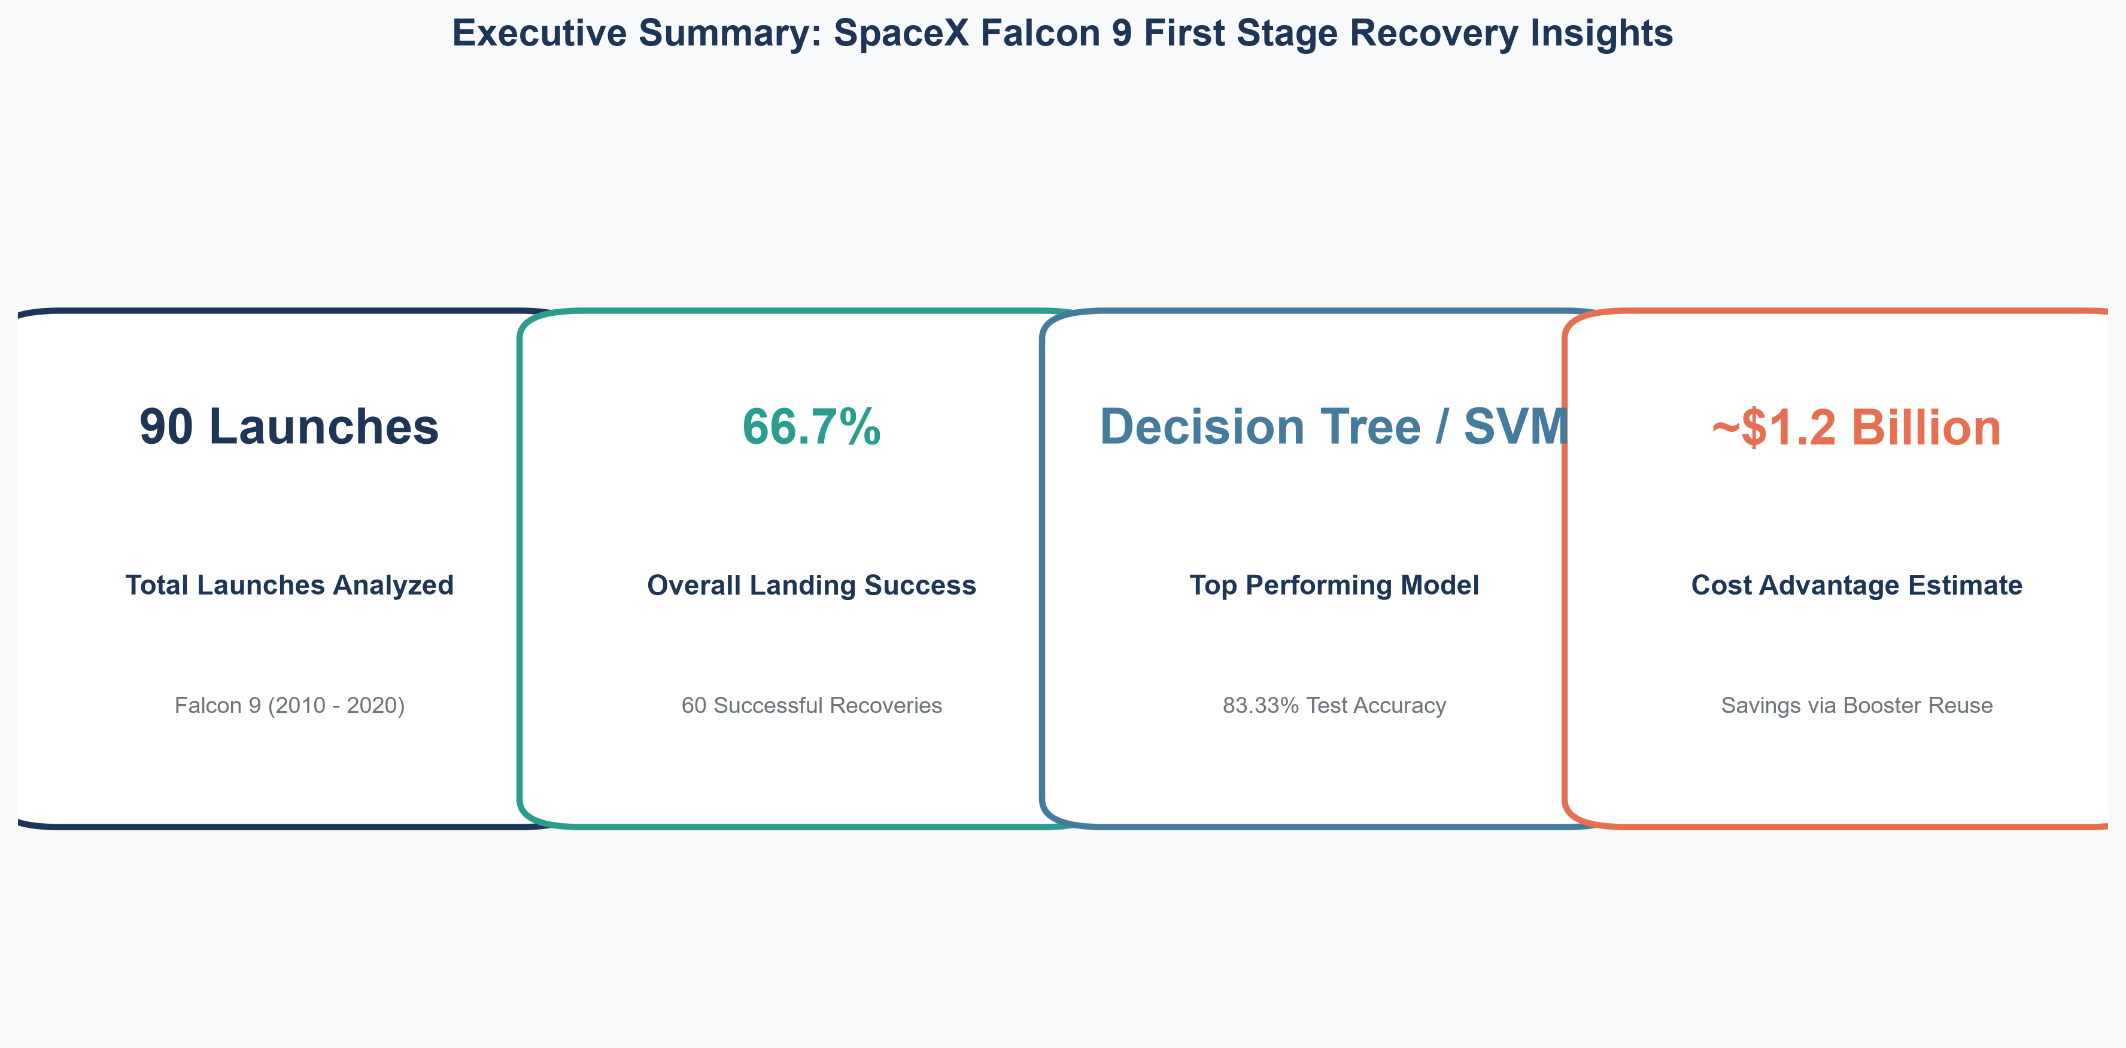
Executive Summary: Methods & Key Results
Rubric 1.3
https://github.com/shravanid307/spacex-capstone.git

Slide 3
Introduction & Business Problem Statement
Rubric 1.4
https://github.com/shravanid307/spacex-capstone.git

Slide 4
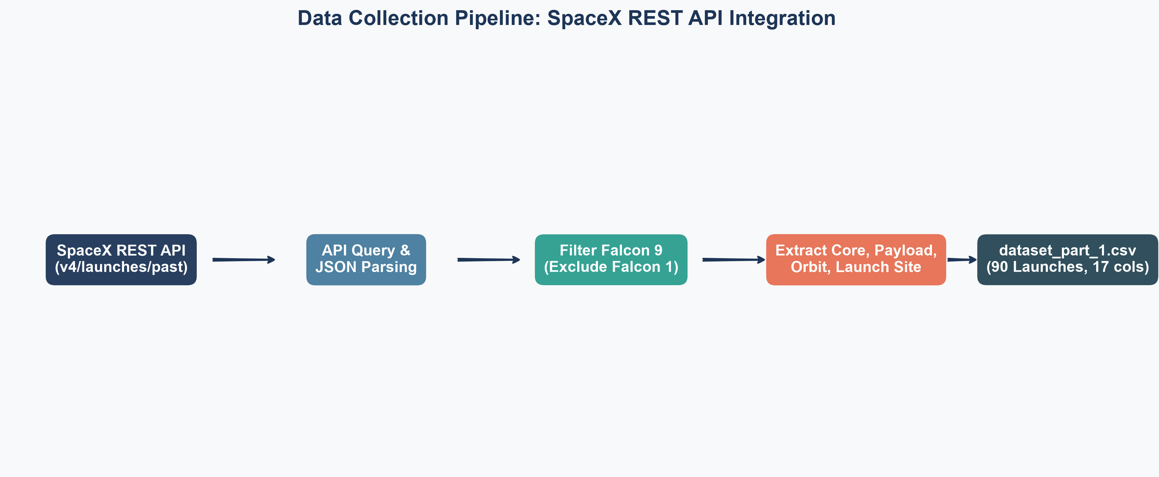
Data Collection Methodology: SpaceX REST API
Rubric 1.5
https://github.com/shravanid307/spacex-capstone.git

Slide 5
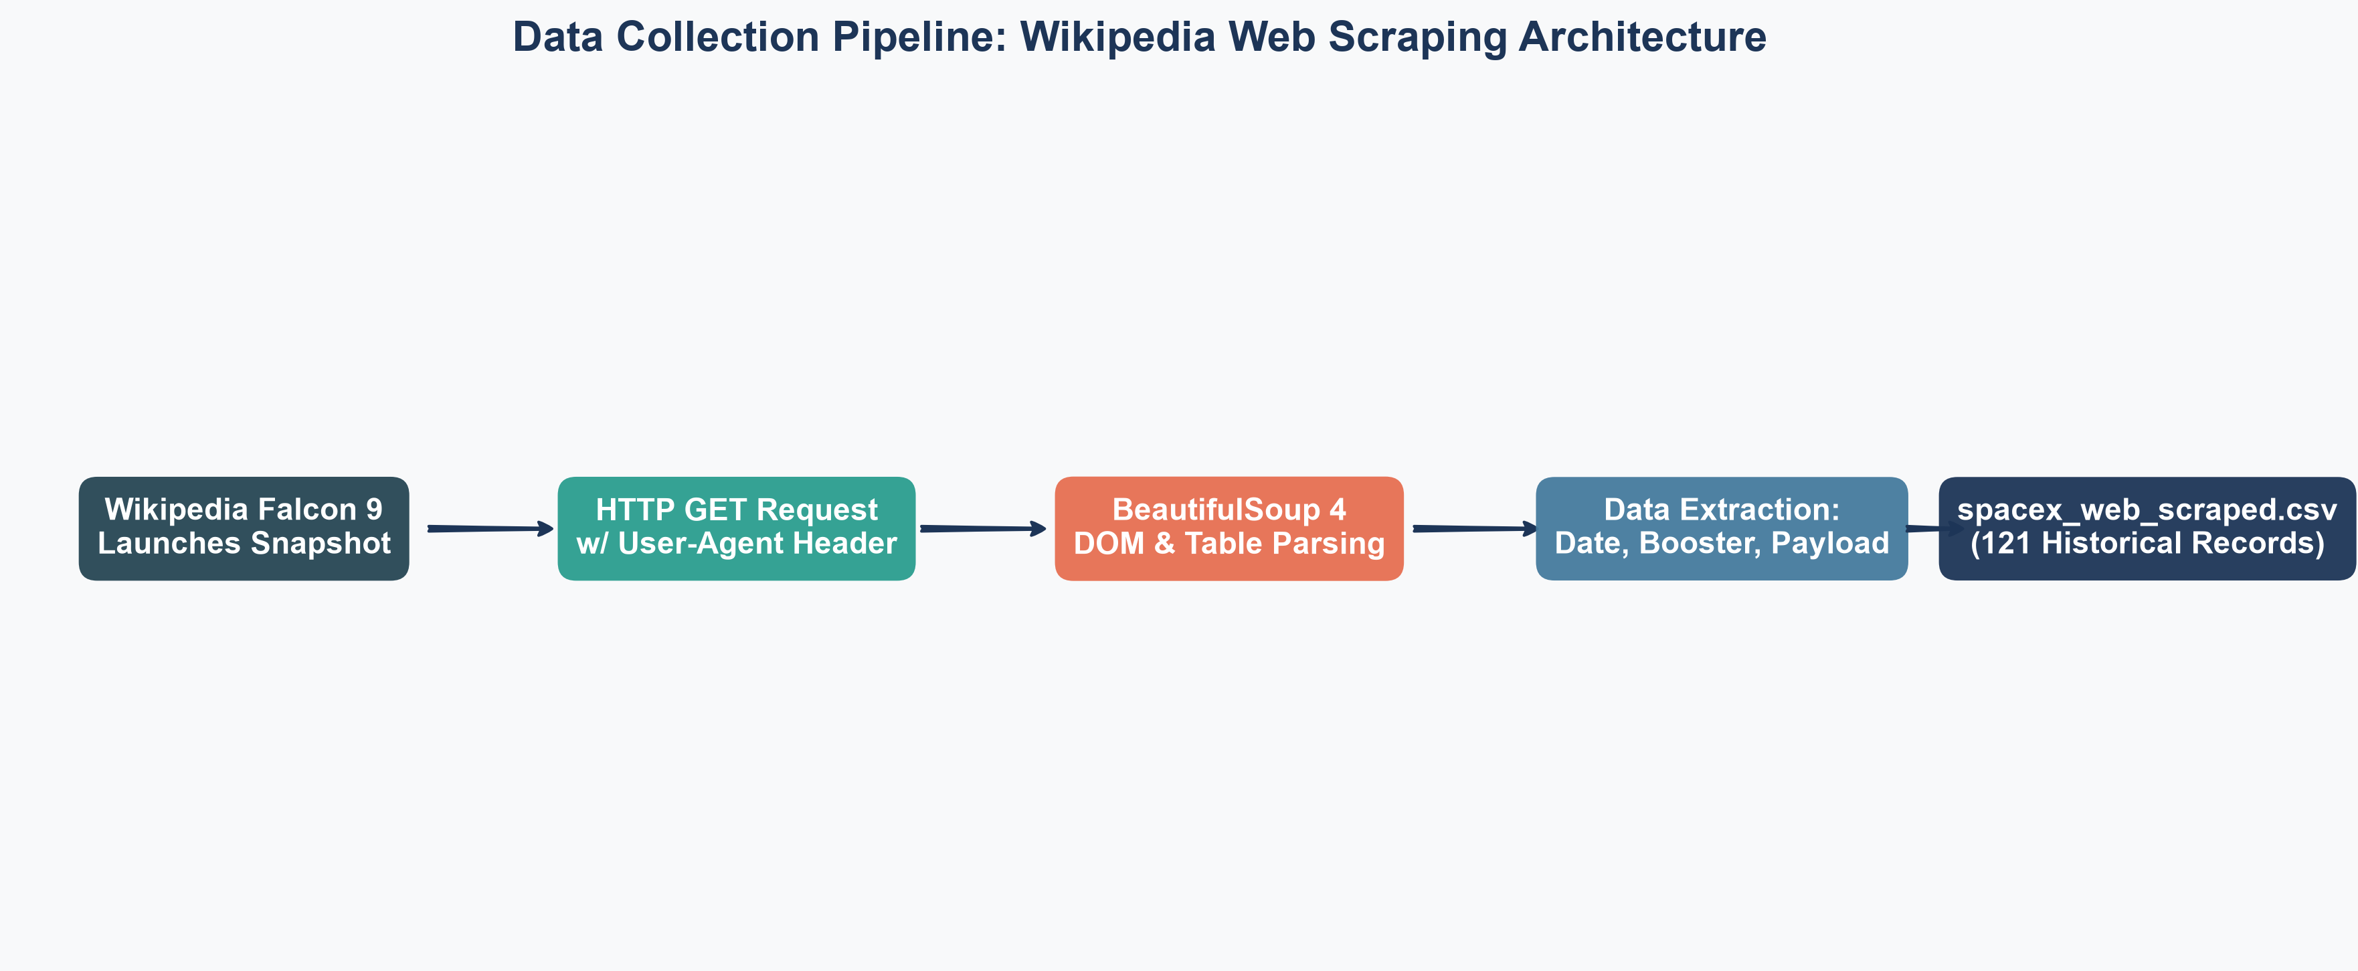
Data Collection Methodology: Web Scraping
Rubric 1.6
https://github.com/shravanid307/spacex-capstone.git

Slide 6
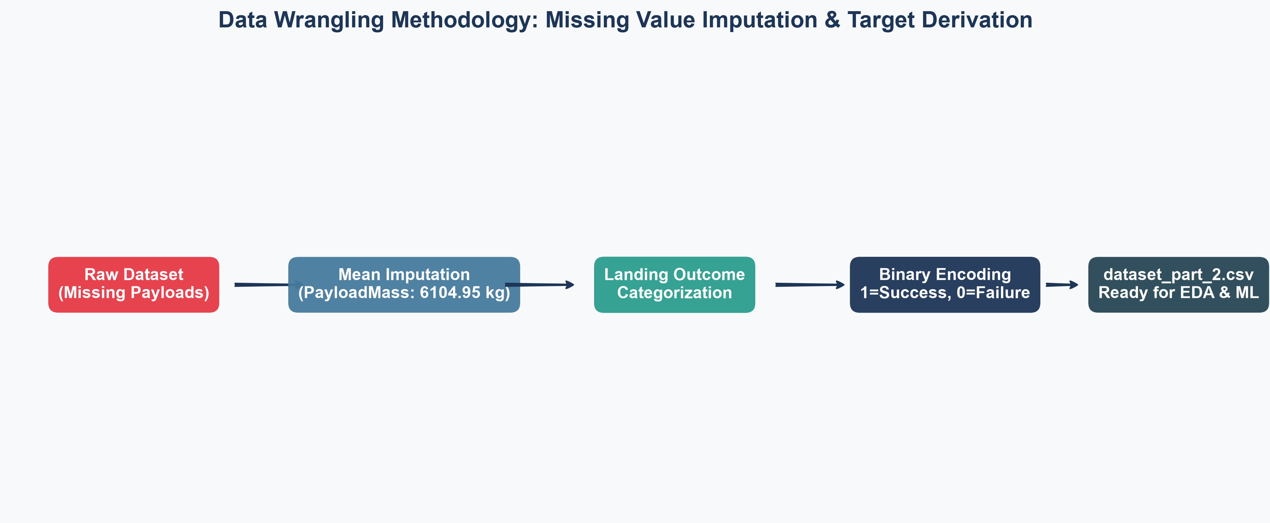
Data Wrangling Methodology: Cleaning & Encoding
Rubric 1.7
https://github.com/shravanid307/spacex-capstone.git

Slide 7
EDA with Data Visualization: Chart Catalog
Rubric 1.8
https://github.com/shravanid307/spacex-capstone.git

Slide 8
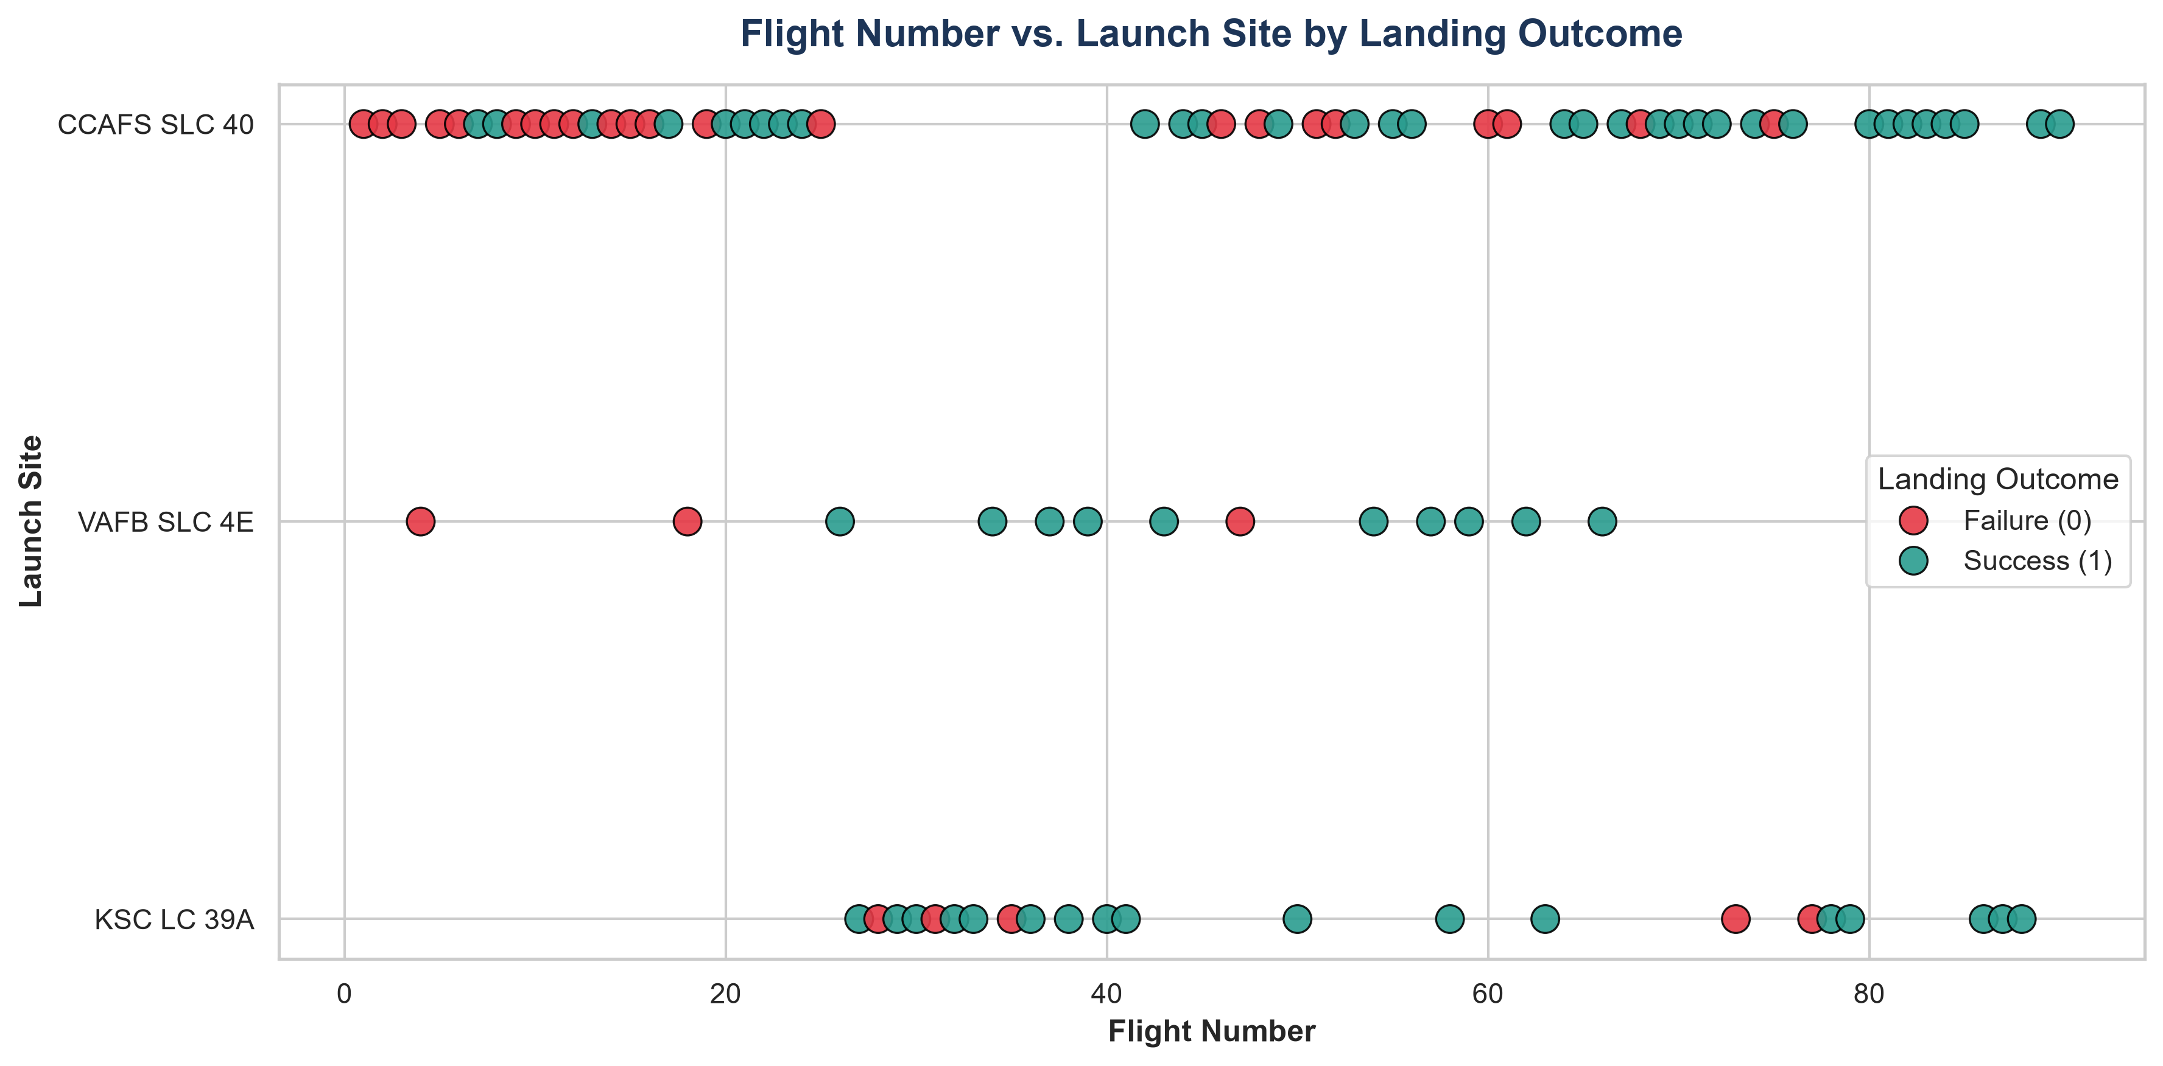
EDA Results: Flight Number & Payload vs. Launch Site
Rubric 1.11
https://github.com/shravanid307/spacex-capstone.git

Slide 9
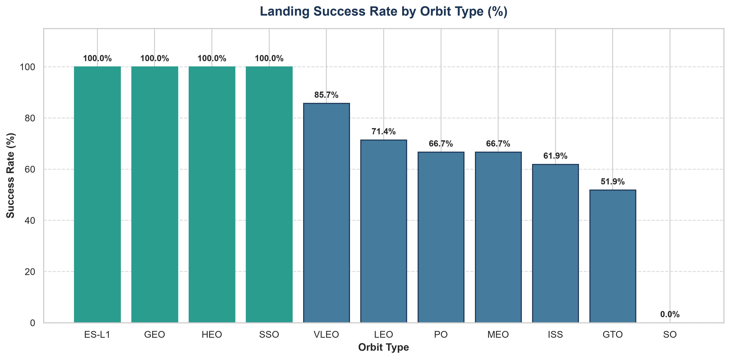
EDA Results: Orbit Success Rates & Yearly Trend
Rubric 1.11
https://github.com/shravanid307/spacex-capstone.git

Slide 10
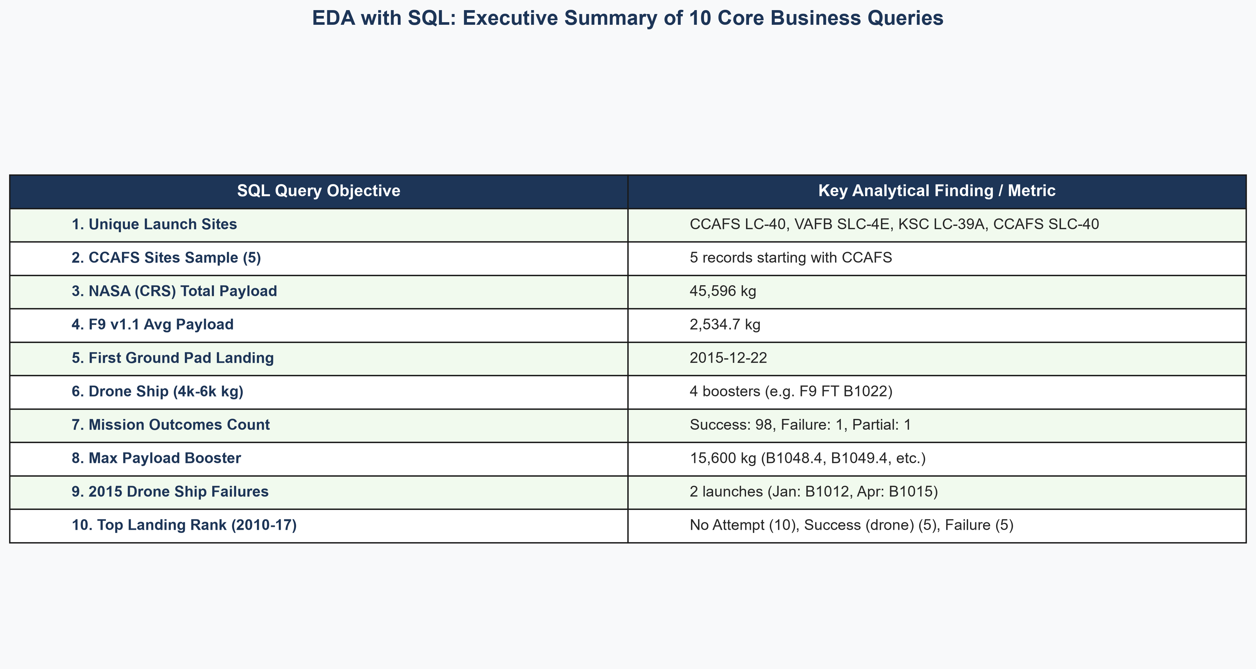
EDA with SQL: Structured Query Architecture
Rubric 1.9
https://github.com/shravanid307/spacex-capstone.git

Slide 11
EDA with SQL Results: Launch Sites, Payloads & Rankings
Rubric 1.12
https://github.com/shravanid307/spacex-capstone.git

Slide 12
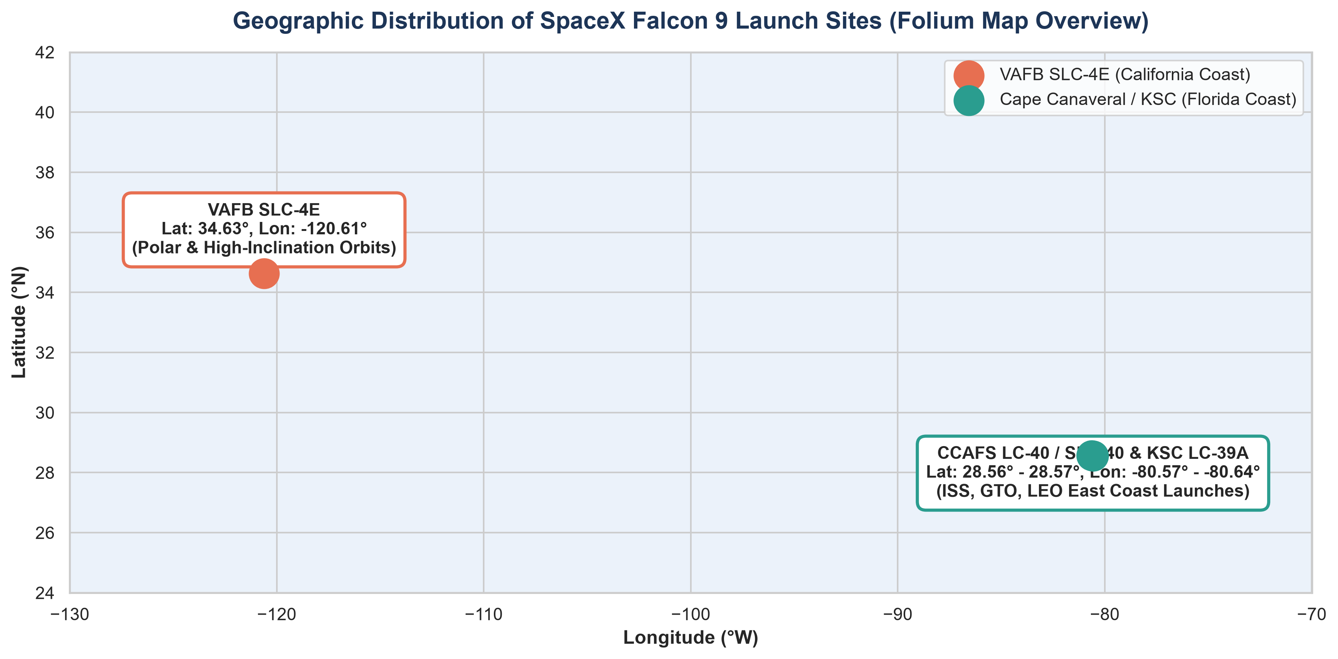
Interactive Visual Analytics: Folium Geospatial Map
Rubric 1.10 & 1.13
https://github.com/shravanid307/spacex-capstone.git

Slide 13
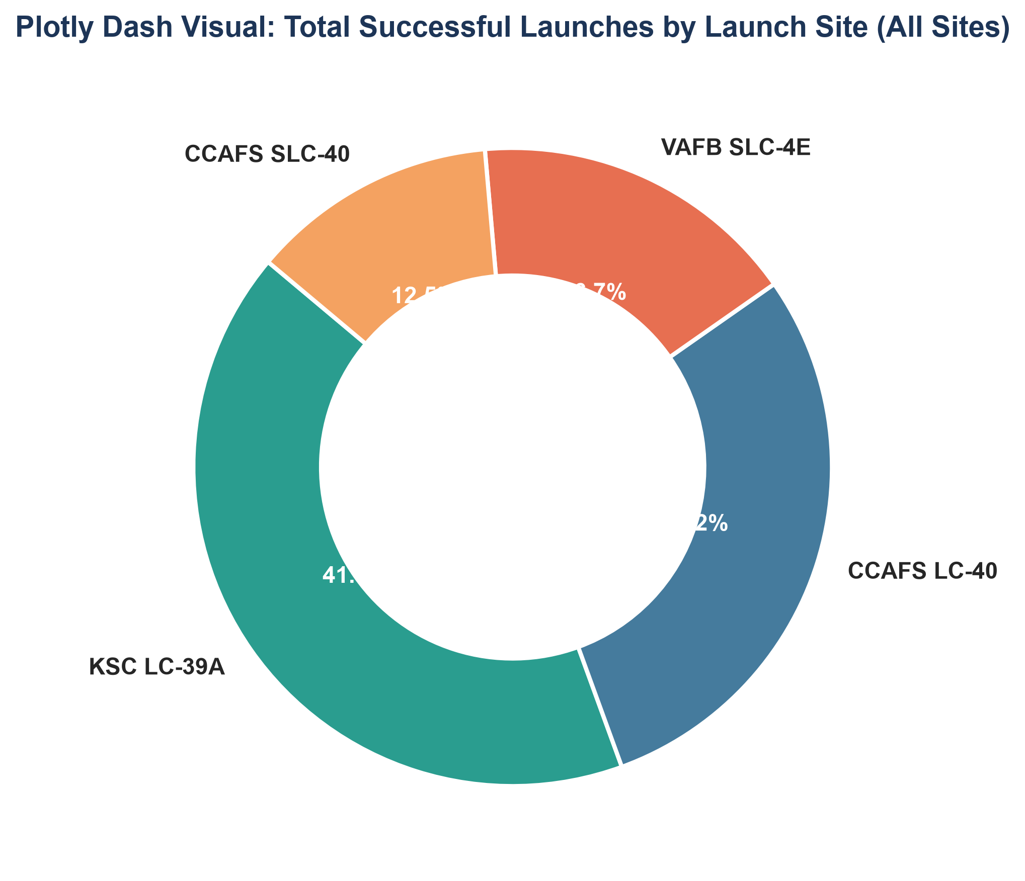
Interactive Visual Analytics: Plotly Dash Application
Rubric 1.10 & 1.14
https://github.com/shravanid307/spacex-capstone.git

Slide 14
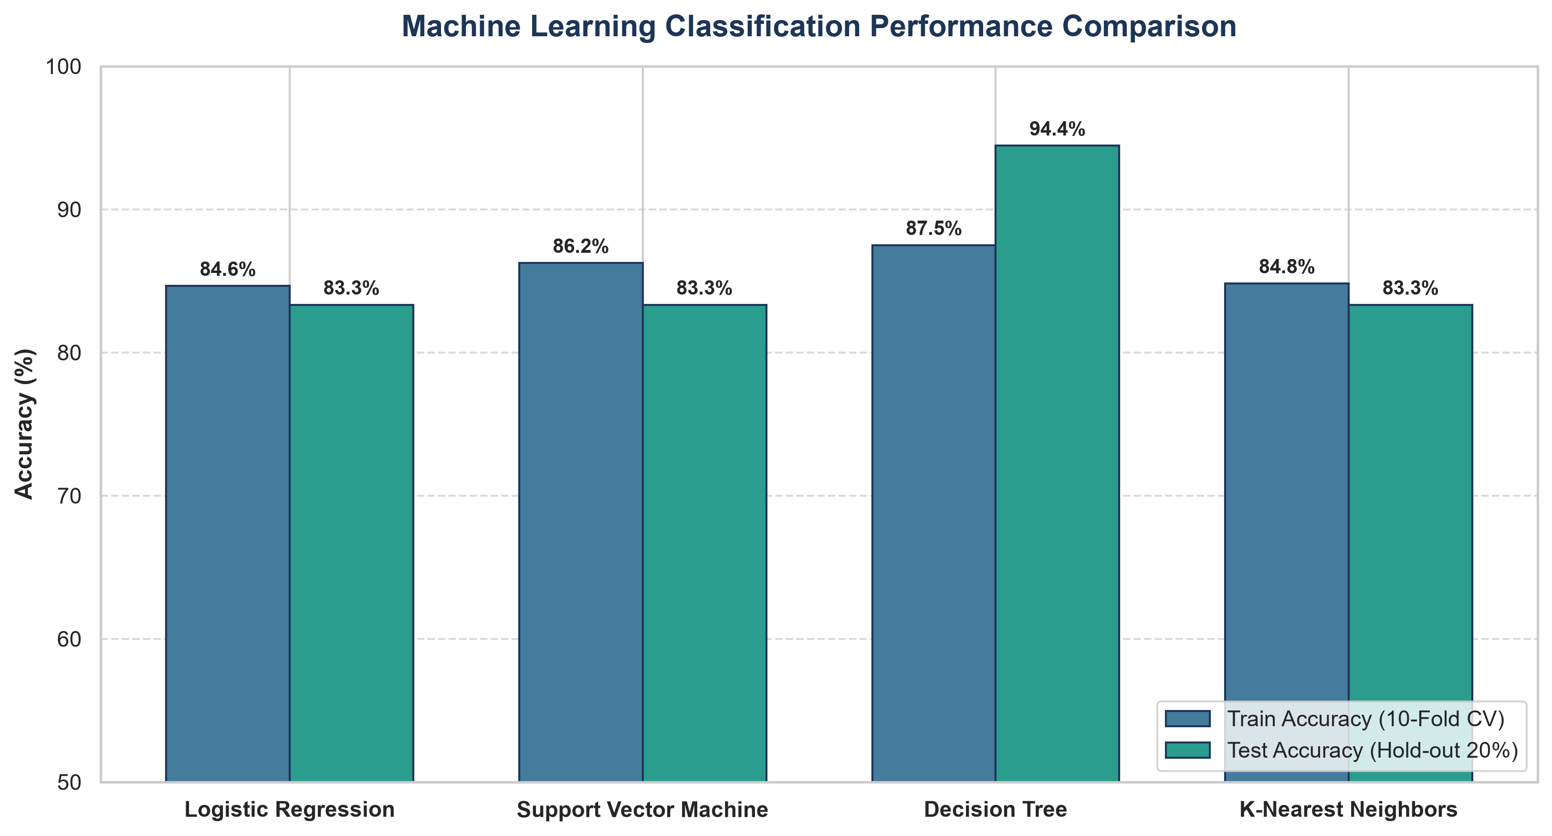
Predictive Analysis: Machine Learning Pipeline
Rubric 1.15
https://github.com/shravanid307/spacex-capstone.git

Slide 15
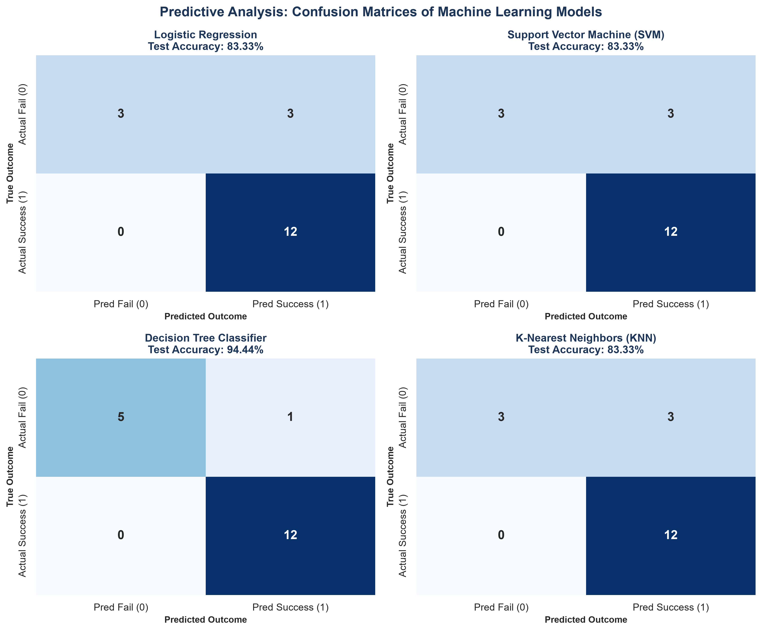
Predictive Analysis: Confusion Matrices & Evaluation
Rubric 1.15
https://github.com/shravanid307/spacex-capstone.git

Slide 16
Best Model Selection & Innovative Business Insights
Rubric 1.15
https://github.com/shravanid307/spacex-capstone.git

Slide 17
Conclusion & Capstone Verification Checklist
Submission Summary
https://github.com/shravanid307/spacex-capstone.git

